Slide 1
EMPLOYEE DATA ANALYSIS USING EXCEL
STUDENT NAME: K.PAVITHRA
REGISTER NO:312220623/1061B643A61FBE2A29145450C69376E8
DEPARTMENT:B.COM(ACCOUNTING & FINANCE)3RD YEAR
COLLEGE:VALLAL P. T. LEE CHENGALVARAYA NAICKER ARTS AND SCIENCE COLLEGE,CHOOLAI,CHENNAI-112

Slide 2
PROJECT TITLE
USING PIVOT TABLE FOR EMPLOYEE TURNOVER ANALYSIS

Slide 3
AGENDA
Problem statement
Project overview
End users
Our solution and proposition
Dataset description
Modelling approach
Results and discussion
Conclusion

Slide 4
Problem statement
The goal is to analyze employee turnover data to identify trends, patterns, and key factors influencing turnover rates within the organization. By using a pivot table, we aim to gain insights into various aspects such as departmental turnover rates, tenure, and reasons for leaving, in order to inform strategic decisions to improve employee retention.
Context: Employee turnover is a critical metric for any organization as it impacts productivity, morale, and financial costs. Understanding turnover trends can help the organization take proactive measures to reduce unnecessary attrition and enhance overall employee satisfaction.

Slide 5
Project overview
To utilize pivot tables for analyzing employee turnover data to identify key patterns, trends, and contributing factors, and to derive actionable insights that can inform strategies to enhance employee retention and reduce turnover rates.
Data Collection
Ensure data integrity and completeness for accurate analysis
Data Preparation:
Clean and preprocess the data to handle missing values, inconsistencies, and format issues.
Pivot Table Creation:
Develop pivot tables to analyze turnover from multiple dimensions: Department, Job Title, Time Period, and Reason for Leaving.

Slide 6
Who are the end users
Human Resources (HR) Team
HR Analysts: Use pivot tables to identify turnover trends, assess departmental turnover rates, and understand the impact of various factors on employee retention.
Senior Leadership and Executives
CEOs, CFOs, and COOs: Review high-level turnover trends and metrics to make strategic decisions regarding workforce management, budget allocation, and organizational development.

Slide 7
. Department Heads and Managers
Departmental Managers: Use pivot table insights to understand turnover within their specific departments, assess the effectiveness of current retention practices, and identify potential issues affecting their teams.
Recruitment and Talent Acquisition Teams
Recruiters: Analyze turnover data to refine recruitment strategies, understand which roles or departments have higher turnover, and improve the alignment of recruitment efforts with organizational needs.
Learning and Development (L&D) Teams
L&D Specialists: Use turnover analysis to identify training needs and gaps that may contribute to higher turnover rates. Design and implement training programs based on insights from turnover data.
Compensation and Benefits Teams
Compensation Analysts: Assess turnover in relation to compensation and benefits packages to ensure competitiveness and address any issues related to employee rewards and incentives
. Employee Relations Specialists
Employee Relations Managers: Use turnover data to address and resolve workplace issues, enhance employee relations strategies, and improve the overall work environment

Slide 8
OUR SOLUTION AND ITS VALUE PROPOSITION
Solution
Comprehensive Employee Turnover Analysis Using Pivot Tables
Our solution leverages the power of pivot tables to provide a detailed and dynamic analysis of employee turnover within your organization. By structuring and summarizing employee data through pivot tables, we offer a clear, actionable, and insightful view of turnover trends, patterns, and factors influencing employee retention.
Value Proposition:
Data-Driven Decision Making:
Improved Retention Strategies

Slide 9
Dataset description
. Dataset Overview
: The dataset contains comprehensive information about employees and their turnover status. It includes data fields related to employee demographics, employment history, and reasons for leaving. This data will be used to create pivot tables that reveal insights into turnover patterns, departmental differences, and other key factors.
Key Data Fields
Employee ID
Description: Unique identifier for each employee.
b. Department
Description: Department in which the employee was working
. Job Title
Description: Employee's job role or title.
Hire Date
Description: The date when the employee was hired.
e. Exit Date

Slide 10
THE "WOW" IN OUR SOLUTION
Dynamic Data Aggregation:
Custom Views: You can quickly create custom views of your data, such as turnover rates by department, tenure, or time period. This allows you to easily compare different segments of your workforce.
2. Visual Representation:
Pivot Charts: Complement your pivot table with pivot charts to visually represent turnover rates, trends over time, or comparisons between different employee groups.
3. Trend Analysis:
Time Series Analysis: Track changes in turnover rates over time, such as monthly or quarterly, to identify trends or seasonal patterns.

Slide 11
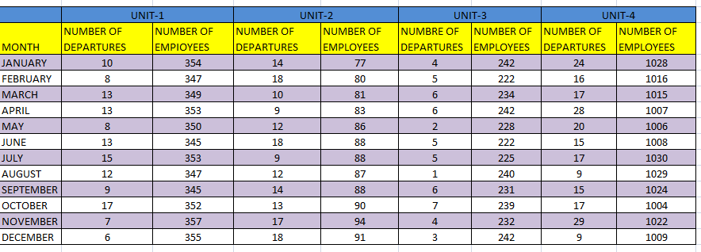
MODELLING

Slide 12
RESULT
TOTAL # OF DEPARTURES | 131
AVERAGE #OF EMPLOYEES | 350.5833333
ANNUAL TURNOVER RATE | 37.36629427

Slide 14
CONCLUSION

Slide 15
THANK YOU

